Slide 1


HPE-CTY
AUTO LOCATE SERVERS IN THE NETWORK
-TEAM
-MENTORS
Hewlett Packard
Enterprise
ANSHA PRASHANT(1BM20CS018)
R P GIRIDHARA(HPE MENTOR)
CHETHAN KUMAR K(1BM20CS034)
REKHA G S (Assistant Professor)
H VIDYASAGAR(1BM20CS053)
Dr. MANJUNATH D R (Assistant Professor)
SHASHANKA G(1BM20CS0147)
MD SURAJ KUMAR(1BM20CS079)
BMS COLLEGE OF ENGINEERING

Slide 2
TABLE OF CONTENTS
01
Problem Statement
02
Devised Solution
Procedure of Implementation
03
04
Technical Prerequisites
BMS COLLEGE OF ENGINEERING

Slide 3

01
PROBLEM STATEMENT
Automatically locate new servers installed in the network without manual intervention by technical staff.
Fetch the serial number,model number,IP-address of newly installed server in the network
BMS COLLEGE OF ENGINEERING

Slide 4
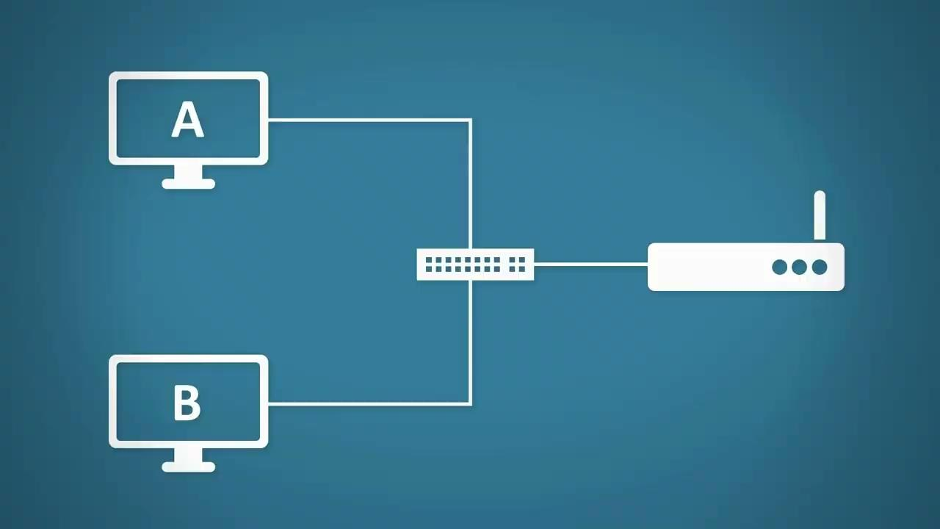
02
DEVISED SOLUTION
Concept of DHCP-DORA procedure to transfer the required details of client to the server automatically.
The 4 packets of DHCP i.e,
DISCOVER
OFFER
REQUEST
ACKNOWLEDGEMENT, will fetch the required details of client machine.
BMS COLLEGE OF ENGINEERING

Slide 5
03
PROCEDURE OF IMPLEMENTATION
Modify the dhcp configuration file in
client with values to be sent to server
Generate discover packets with required data at BOOTUP.
01
02
Fetch the client details from the log file.
Display the fetched details in the designed website.
03
04
BMS COLLEGE OF ENGINEERING

Slide 6

03
PROCEDURE OF IMPLEMENTATION
FLOW OF INFORMATION
SERVER
CLIENT
display
dhclient.conf
DHCP - Message : Discover
Vendor-Class(60):“DL135, HPE435, 345TH,192.168.100.10”
BMS COLLEGE OF ENGINEERING

Slide 7
04
TECHNICAL REQUIREMENTS
DHCP-SERVER
DHCP-CLIENT
details.txt
DHCP-SERVER package to be installed in main server where details are displayed
DHCP-CLIENT package to be installed in new servers to be installed
Details.txt file should be pre-installed with required information in new servers to be installed

Slide 8
REFERENCES
https://linux.die.net/man/5/dhcp-options
https://www.iana.org/assignments/bootp-dhcp-parameters/bootp-dhcp-parameters.xhtml#options
http://blog.schertz.name/2012/05/understanding-dhcp-option-43/
https://www.youtube.com/watch?v=1gk8xgvxT30
https://linux.die.net/man/5/dhclient.conf
https://serverfault.com/questions/709118/how-to-configure-dhclient-on-centos-to-get-ip-from-a-specific-dhcp-server

Slide 9

THANK YOU!!

